Slide 1
Interval Forecasting of Cryptocurrency Returns using
Quantile Regression Forests:
An Application to the Solana Ecosystem
James Lewis
06/25

Slide 2
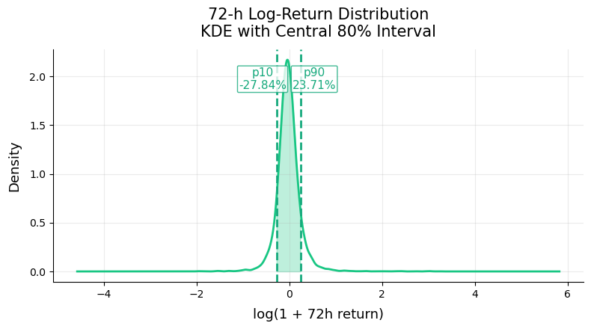
Do Quantile Regression Forests outperform traditional methods in forecasting risk-adjusted return intervals for mid-cap Solana tokens?
Research Question & Motivation
Interval forecasting is widely used in equities and FX, but its application to volatile and skewed crypto returns, especially in the Solana ecosystem, remains under-explored.
Research gap
Demonstrates the power of Quantile Regression Forests for calibrated, distribution-free tail-risk forecasting in crypto, benchmarking QRF against established and machine-learning baselines.
Scientific contribution
Accurate 10th/90th percentile forecasts enable dynamic risk management pre-emptive exposure reduction during high-risk periods and risk-adjusted position sizing to enhance returns and limit drawdowns in fast moving markets.
Trading utility
Notes:
Research Gap: Interval forecasting is widely used in equities and FX, but its application to volatile, skewed crypto returns—especially in the Solana ecosystem—remains under-explored.
Scientific contribution: Demonstrates the power of Quantile Regression Forests for calibrated, distribution-free tail-risk forecasting in crypto, benchmarking QRF against established and machine-learning baselines.
Trading utility: Accurate 10th/90th percentile forecasts enable dynamic risk management—pre-emptive exposure reduction during high-risk periods and risk-adjusted position sizing to enhance returns and limit drawdowns in fast-moving markets.

Slide 3
Literature Review & Key Concepts
Foundations of Quantile Regression
Tree Ensembles & Machine Learning
Conformal Interval Calibration & Probabilistic Forecasting
Cryptocurrency Forecasting & Risk
Recent Advances & Relevant News
Koenker & Bassett (1978): Linear QR theory, core for interval forecasts
Meinshausen (2006): Non-parametric quantile regression forests
Takeuchi et al. (2006): Quantile regression in time series context
Breiman (2001): Random forests, ensemble learning
Friedman (2001): Gradient boosting, basis for LightGBM/XGBoost
Ke et al. (2017): LightGBM, efficient quantile estimation
Gneiting et al. (2007): Forecast evaluation & calibration
Romano et al. (2019): Conformalized quantile regression
Papadopoulos et al. (2002): Conformal prediction for distribution-free intervals
Liu & Tsyvinski (2022): Factor structure in crypto returns
Görgen (2022): ML GRF outperforms GARCH for crypto VaR
Borri (2018): Conditional tail risk in crypto markets
New arXiv / ScienceDirect papers
Crypto Articles: CoinDesk and Financial Times
“Solana's SOL Holds $140 Support as Reversal Pattern Gains Strength”
“Ether, Solana, Cardano Spike 7% as Trump Claims to Broker Israel-Iran Ceasefire”

Slide 4
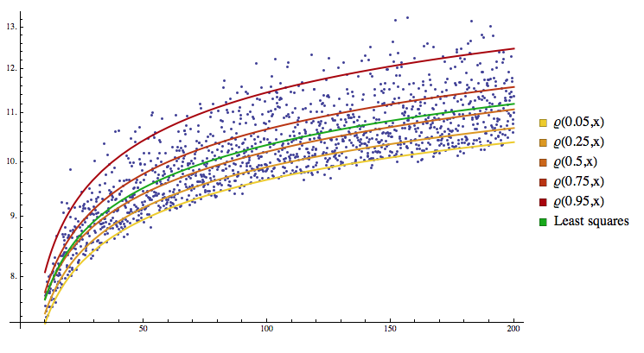

Slide 5
Data, Feature Engineering & Project Progress
Data Engineering & Collection
Data Cleaning & EDA
Feature Engineering & Top Predictors
8,300+ raw rows, 29–35 variables per token
Data collected entirely by me from:
CoinGecko API: historical price & OHLCV
SolanaTracker API: order book, market cap, holders
Google BigQuery: Solana blockchain data
Helius API: advanced on-chain activity
Benchmarks: BTC, ETH, SOL price & DeFi TVL
23 tokens (filtered to 20 after QA)
Comprehensive panel assembly:
12h-aggregated OHLCV, on-chain, context variables
Dropped tokens with >30% missing, clipped “late-starter” rows
Imputation:
OHLCV forward-fill/interpolate (≤2 bins) → zero missing
Final cleaned dataset: 6,314 rows × 35 features
Diagnostics:
Missingness heatmaps, return/volatility histograms (heavy tails, volatility clustering), correlation matrices (Pearson/Spearman), and more.
Final feature set: 35 engineered features, grouped:
Momentum: log returns (1, 3, 36, 72h), RSI, proc, cci, stoch_k
Volatility: realized volatility, ATR, bollinger_bw, adx
Liquidity: spread, depth, volume
Macro/Benchmarks: BTC/ETH/SOL returns, TVL
On-chain: holder growth, tx count
Regimes: market/bucket, tail labels
Pipeline modularity: All cleaning and EDA scripts reproducible via Python scripts & notebooked

Slide 6
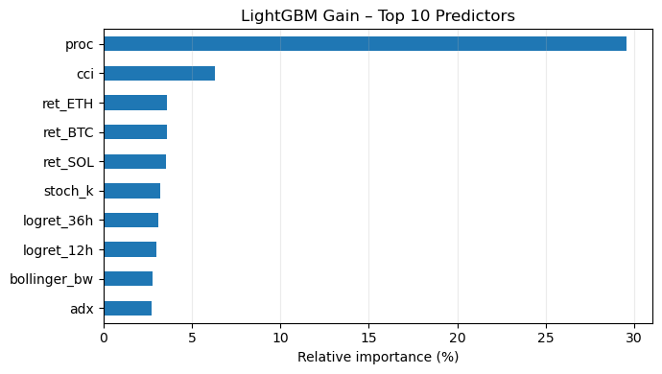
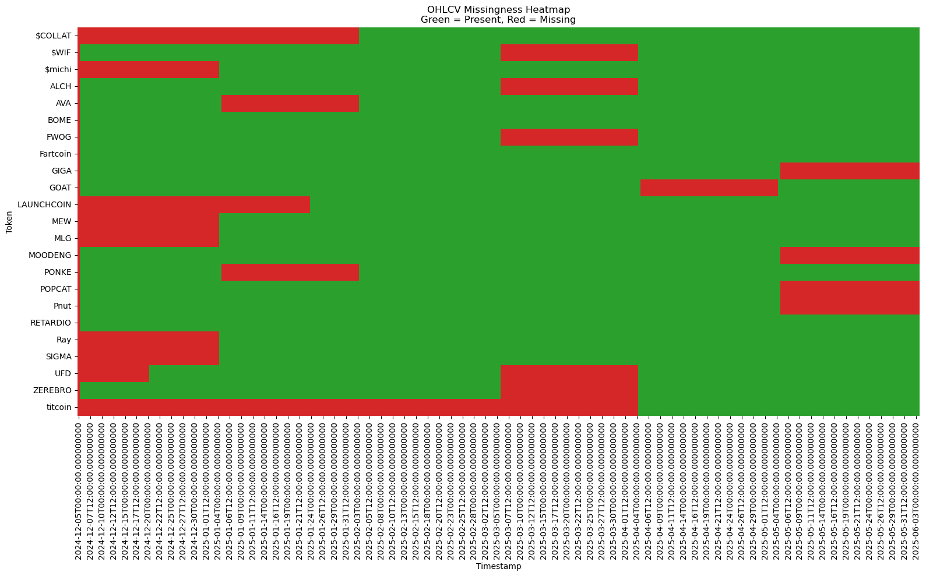
Data Diagnostics & Feature Importance
OHLCV Missingness Heatmap
Top 10 Predictors
Ensured all core price fields are fully imputed for final dataset
Confirms value of engineered momentum and macro features. Price Rate of Change feature - 29% gain

Slide 7
Technical Road Map
Modelling Phase
Key Technical Steps
Open Source & Write up
Linear Quantile Regression (baseline)
LightGBM with bootstrapped intervals
Quantile Regression Forests (QRF)
Hyperparameter tuning (grid search, cross-validation for all models)
Interval calibration: empirical coverage, pinball loss
Model comparison
Backtesting: Simulate interval-based trading/position sizing
Ablation & interpretability: Feature importance, retrain with top-k variables
All of this research can be found on my GitHub, from Data Ingestion Scripts and Datasets, to Python Notebooks.
All scripts are reproducible
https://github.com/KetchupJL

